Slide 1
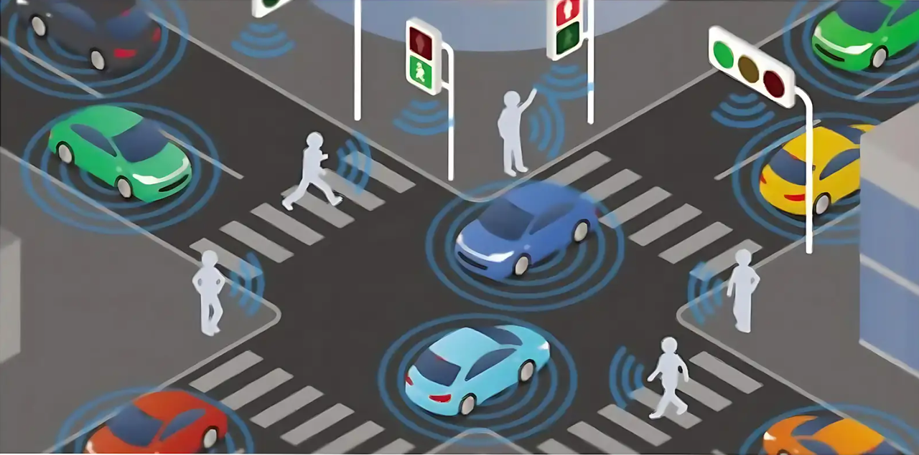

TraffIQ
Smart Traffic Signal Optimization

Slide 2


Project Overview
TraffIQ aims to develop a dynamic traffic light control system using Reinforcement Learning integrated with SUMO.
The RL agent learns optimal signal policies based on real-time traffic states to minimize average wait time and improve throughput.
Starting with a single intersection and scaling to complex networks.

Slide 3

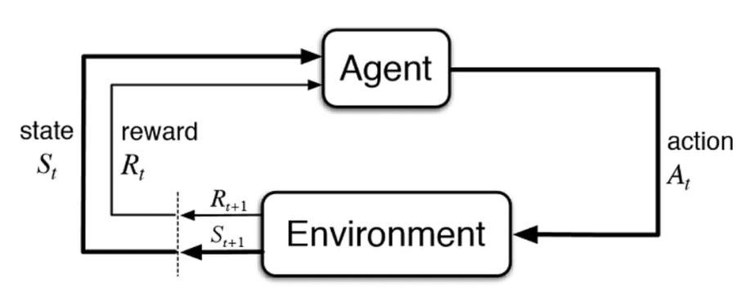
CURRENT PROGRESS
01
REINFORCEMENT LEARNING
An agent interacts with an environment to learn a policy that maximizes long-term reward via trial-and-error.
RESOURCES:
Reinforcement Learning Course by David Silver
Deep Learning and Neural Networks Introduction Course 1 by Andrew NG
02
MDPS & VALUE FUNCTIONS
RL is formalized as a Markov Decision Process (MDP). Agents aim to learn the optimal policy (π*) using value functions (V, Q) governed by the Bellman Optimality Equation.

Slide 4
03
MODEL-FREE PREDICTION (TD LEARNING)
Learns value functions without knowledge of the environment's transition model.
Uses bootstrapped updates (e.g., TD(0)) to estimate V(s) from sampled transitions.
Balances bias and variance better than Monte Carlo methods.
Enables online, incremental learning during agent–environment interaction
MODEL-FREE CONTROL (SARSA & Q-LEARNING)
Learns optimal policies without a model by directly interacting with the environment.
SARSA (on-policy): updates
Q(s,a) using the action actually taken.
Q-Learning (off-policy): updates (Q(s,a) using the maximum estimated value of the next state.
Suitable for large-scale problems where modeling transitions is impractical.

Slide 5


TAXI: The Multi Objective Open AI Gym Env
Action Space
State
Space
250 Discrete States
-5X5 Grid for Taxi Loc
-5 options for passenger
-4 options for apartment
0: Move south (down)
1: Move north (up)
2: Move east (right)
3: Move west (left)
4: Pickup passenger
5: Drop off passenger
Rewards
-1 per step
+20 delivering passenger.
-10 “pickup” and “drop-off” actions illegally.

Slide 6

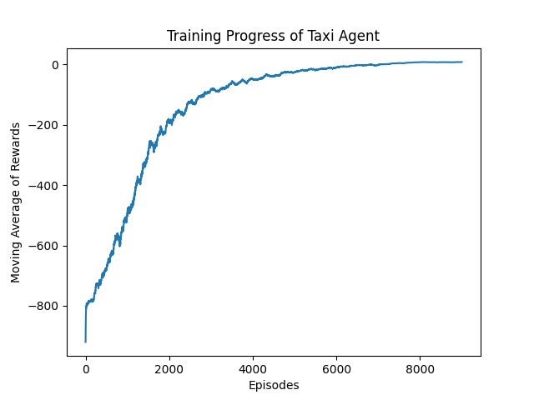
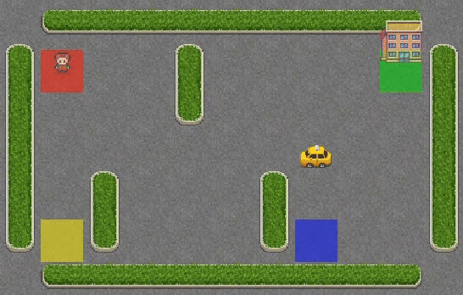
Performance Evaluation

Slide 7

Frozen Lake (Slippery) OpenAI Gym Env
State Space
Reward Structure
Action Space
4X4 Grid
-Goal at 16th cell
-4 Holes
-16 Discrete States
Reach goal: +1
Reach hole: 0
Reach frozen: 0
0: Move left
1: Move down
2: Move right
3: Move up
The slippery mode incorporates a ⅓ probability for intended action. 2/3 chances for slipping to perpendicular direction.

Slide 8

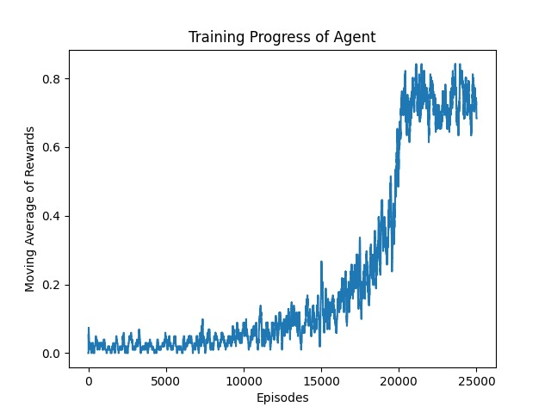

Performance Evaluation

Slide 9

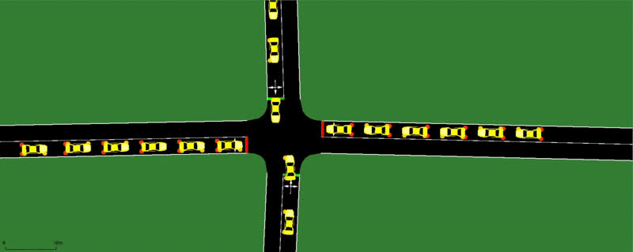
Fixed TLS Logic in a 4-way intersection
using SUMO

Slide 10
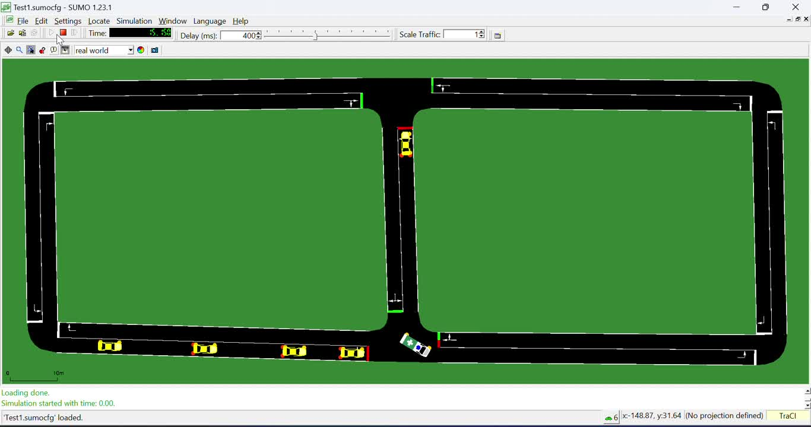
SUMO Traffic Light: Signal
Preemption/Priority for Emergency Vehicles

Slide 11
Project Workflow
01
02
03
04
-Genetic algorithm for optimizing among many possible solutions.
-Q Learning & DQN on a single intersection
Multi Agent implemented with Policy Gradient methods like PPO on multiple intersection
-Implementing real city maps using OSM Web Wizard
-Data for testing using YOLO on real world videos
Performance Evaluation using RESCO Metrics

Slide 12


Thank You
Mentees: Ojas Alai, Sofia Abidi
Mentors: Yashvi Mehta , Mahi Palimkar

